Slide 1

Final Project-2 Bank Loan Case Study
Submitted By
Anusha Gaira
anushagaira@gmail.com

Slide 2
Content
Project Description
Approach
Tech-stack Used
Insight
Result

Slide 3
Project Description
The aim of this project is to identify and analyzing the factor to identify the difficulty faced by customer during their installment. With the EDA(Exploratory data analysis) bank will understand the patterns in loan application data and they will ensure that applicant not rejected with the help of given dataset.
Dataset contain information about loan application, amount credited and details about customer and loan approval that will help bank from loss and it will contribute to bank risk management growth that will help them to balance business growth with financial stability.

Slide 4
Approach
Data Cleaning – We have used the downloaded dataset then we used the Microsoft excel for cleaning the data. firstly we searched for blank data and replace them with null and average.
EDA- After Cleaning the data we used the Exploratory Data Analysis by determine the total non null values and null percentage of cell. we deleted all the cell which have more than 30 percent of null data.
Data Analysis – After cleaning the data we performed the data analysis for finding out the problem faced by customer while paying the loan amount.so that bank can make better decision about loan approval

Slide 5
Tech stack used
Tech stack used in this project is Microsoft Excel 2016
We used the different functions of excel for analysis and statistical distribution like pivot table, charts which provide us the clear understanding of Bank Loan Analysis.

Slide 6
A. Identify Missing Data and Deal with it Appropriately
By Analyzing the data we come across missing data in the loan application dataset. It is essential to handle missing data effectively to ensure the accuracy of the analysis.
Insight – we perform the EDA for cleaning and handling the missing information .we have counted the non null values of the data and after that we calculated the null percentage of data. We have deleted all the data which have more than 30 percent of null values.
This analyses will help us to remove the unnecessary information from dataset.

Slide 7
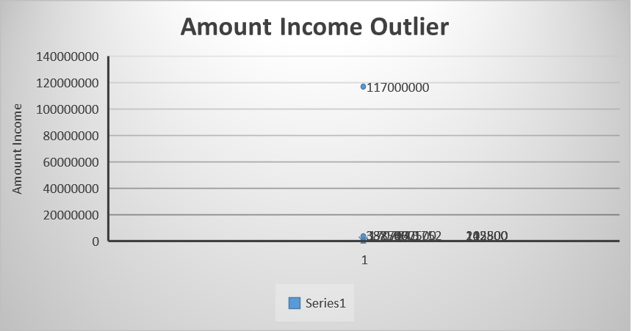
Identify Outliers in the Dataset
Outliers can significantly impact the analysis and in the results. We need to identify outliers in the loan application dataset using Excel statistical function and feature

Slide 8
Amount Income Descriptive Analysis
Mean | 170767.5905
Standard Error | 2378.391081
Median | 145800
Mode | 135000
Standard Deviation | 531819.0951
Sample Variance | 2.82832E+11
Kurtosis | 46582.52582
Skewness | 212.0777967
Range | 116974350
Minimum | 25650
Maximum | 117000000
Sum | 8538208758
Count | 49999
Insight – By Identifying and analyzing outliers in dataset ,we can gain deeper insight into characteristics and behavior of different applicant segment by observing the disparity among different level. It will help us to improve the accuracy of risk management and loan approval decision.

Slide 9
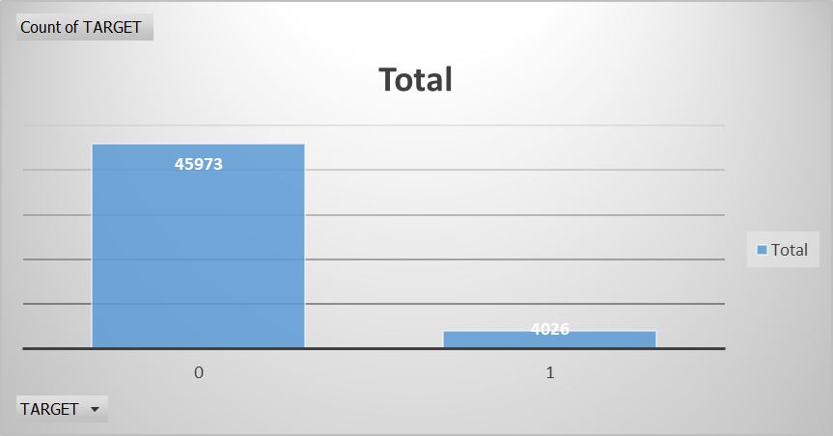
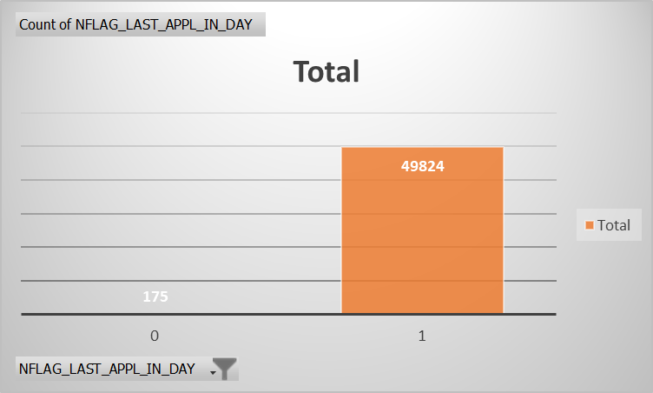
C . Analyze Data Imbalance
Data imbalance can affect the accuracy of the analysis, especially for binary classification problems. Understanding the data distribution is crucial for building reliable models. We will determine if there is data imbalance in the loan application dataset.

Slide 10
Insight – By determining and visualizing data imbalance , we can gain valuable insight into the distribution of target variable, which is very important for building accurate and fair predictive analysis and making informed business decision without any imbalance.
Target | Count
0 | 45973
1 | 4026
Grand Total | 49999
Target | Percentage
0 | 92%
1 | 8%

Slide 11
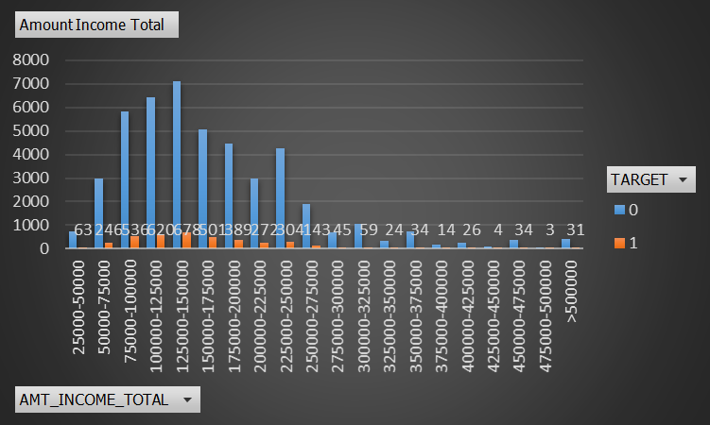
D. Perform Univariate, Segmented Univariate, and Bivariate Analysis
To gain insights into the driving factors of loan default, it is important to conduct various analyses on consumer and loan attributes. We have Performed the univariate analysis to understand the distribution of individual variables, segmented univariate analysis to compare variable distributions for different scenarios, and bivariate analysis to explore relationships between variables and the target variable using Excel functions and features.
SEGMENTED UNIVARIATE
Analysis For Amount Total
with Target 0 and 1

Slide 12
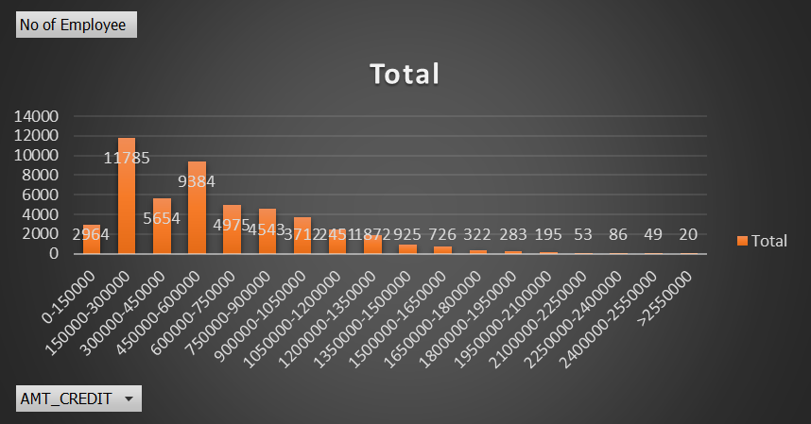
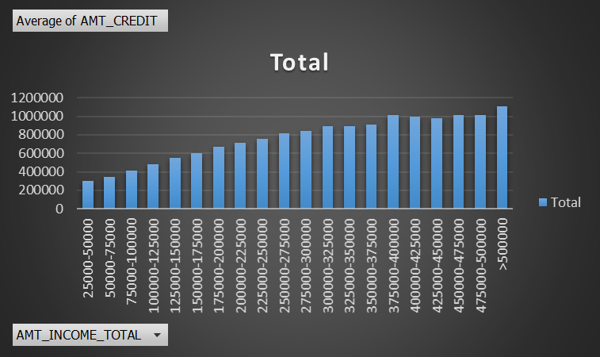
Insight – By Performing these analysis, the company can gain a deeper understanding of the driving factors behind loan default and develop strategies to mitigate risk, enhance decision making process, and improve overall financial stability. With the help of univariate ,segmented univariate and bivariate analysis to make informed decision about loan approvals , interest rates, and risk management.
UNIVARIATE ANALYSIS FOR AMOUNT CREDITED Bivariate Analysis for Average amount
Credit and amount of income total

Slide 13
Identify Top Correlations for Different Scenarios
Understanding the correlation between variables and the target variable can provide insights into strong indicators of loan default. Segment the dataset based on different scenarios (e.g., clients with payment difficulties and all other cases) and identify the top correlations for each segmented data using Excel functions.
Insight – By Segmenting the data and identifying top correlation, the company can gain the deeper insight into the factors driving loan defaults. This knowledge enables more informed decision-making, better risk management, and the development of targeted strategies to reduce default rates and improve financial performance.

Slide 14
Result
This Project involved extensive use of Excel. the major challenge was working with large dataset.
With this huge data project helped me understand how to work with large data and how to handle the missing data.
The dataset involved a lot of outlier which were affecting the accuracy of risk management and risk management.
It helped me to understand the correlation between the data.
It also helped me to elaborately analyzing the data.
Sheet Hyperlink – ApplicationData and PreviousApplication
Video Hyperlink - Videotrainity

Slide 15


Thank You

